Slide 1

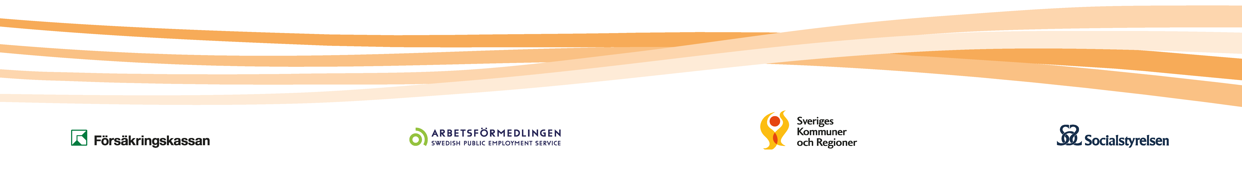
Financial Coordination

Slide 2

Swedish Law (2003:1210)
The Law of Financial Coordination came into force on January 1, 2004.

Slide 3
Common resources used more efficiently
Financial coordination takes place between the Social Insurance Agency, The Public Employment Service, municipalities and county councils through
Coordination Agencies
Notes:
By collaborating, it is possible to do more for people who need different types of rehabilitation efforts from several actors at the same time. When society's efforts are coordinated, our common resources are used more efficiently.

Slide 4
Why Coordination Agencies?
The target group are individuals in need of coordinated services from two or more of the organisations involved in the coordination agency
More integrated approach
Sometimes the individual need solutions that demand a more comprehensive view
Knowledge from different areas
The authorities have different goals and missions, and the responsibility is sometimes unclear
More efficient coordination
Notes:
Case study for European Agency for Safety and Health at Work 18/12/2015
With the Act on Financial Coordination
of Rehabilitation Measures

Slide 5

Collaborating parties
The Social Insurance Agency – Government agency responsible for social insurance. The agency is responsible for coordinating the various rehabilitation measures that a person needs to get back to work.
Försäkringskassan
Notes:
Everyone who lives or works in Sweden is entitled to social insurance and the agency ensures that people receive the benefits and allowances to which they are entitled.

Slide 6

Collaborating parties
Public Employment Service – National government agency providing job placement services. The agency’s assignment includes rehabilitation, as it contributes to the return to work of persons with reduced working capacity.
Arbetsförmedlingen
Notes:
They offer individually adapted activities for persons who have not been able to work because of sickness.

Slide 7

Collaborating parties
There are 290 municipalities in Sweden.
The municipalities are responsible for social services through their own self-governing local authorities.
Kommuner
Notes:
The local authorities have tax-raising powers and are responsible for supplying welfare services to their citizens.

Slide 8

Collaborating parties
Sweden is divided into 20 county councils. The county councils are responsible for all publicly financed health care.
Regioner

Slide 9
Common resources used more efficiently
Pooled financing gives economic incentives to collaborate.

Slide 10
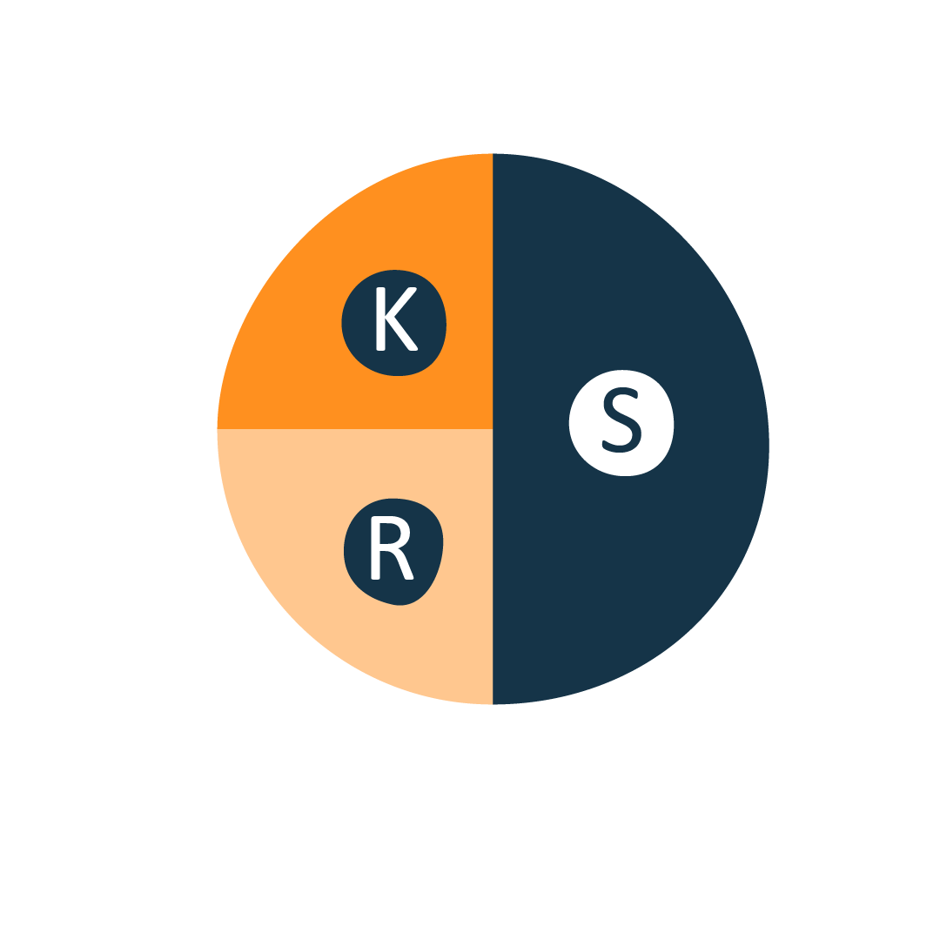
Financing
Half of the financing is provided by the state, the rest is divided between municipalities and county councils.
Notes:
The Swedish Social Insurance Agency (Försäkringskassan) and the Public Employment Service, (Arbetsförmedlingen), 50 %
Municipalities 25 %
County Councils 25 %

Slide 11

Financing in 2019
The state contributed 339 million Swedish crowns in 2019 (50 per cent of total), municipalities och county councils the same amount.
80 per cent of the costs for interventions targeting individuals
20 per cent of the costs for interventions targeted towards better local collaboration
Notes:
Varje myndighet bidrar med 25 procent var

Slide 12
Coordination Agencies
In total, there are about 80 Coordination Agencies.
Almost every Swedish municipality is a member of a Coordination Agency

Slide 13
Organisation of the Coordination Agencies
A statutory body.
Led by a board where each board member is assigned by each member organisation.

Slide 14
The national organisation of Coordination Agencies
Collectively organised in The National Association of Coordination Agencies
Supported by The National Council consisting of The Social Insurance Agency, The Public Employment Service, The National Board of Health and Welfare and Swedish Association of Local Authorities and Regions

Slide 15
Interventions
Interventions targeting individuals
  Social, medical and occupational rehabilitation efforts staffed by professionals from member organisations
Interventions targeted towards better local collaboration
  In various ways promote local collaboration. Can for example be shared training programmes or joint efforts to find better working methods
Notes:
Samordningsförbundet finansiera insatser som bedrivs av de samverkande parterna.

Slide 16

Who gets support?
Individuals in working age 16–64 years who may have physical, mental, social and/or work-related needs, and is in need of coordinated support from two or more of the collaborating parties
The goal is to become self-sufficient
Notes:
Nearly five percent of the working-age population is in need of coordinated support to increase work ability and self-sufficiency

Slide 17
What support can individuals receive?
An early joint assessment by the authorities involved
A common action plan
A combination of efforts over a longer period.

Slide 18
A few numbers
In 2019, 31,167 participants participated in 599 different activities:
53 per cent individual-oriented activities and 47 per cent structurally-oriented interventions
11,000 participants have completed a jointly financed activity, 55 per cent women, 45 per cent men
  16 per cent worked/studied before starting work
  31 per cent worked/studied after completing the activity

Slide 19
Interventions targeting individuals
Rehabilitation for work/education – 52 percent of the activities are designed for individuals to start or continue work/studies.
Rehabilitation
for work/education

Slide 20
Interventions targeting individuals
Preparatory work – 25 percent of the activities are aimed at preparing the individual for work/studies.
Preparatory work
Rehabilitation
for work/education

Slide 21
Interventions targeting individuals
Mapping individuals – 12 per cent.
Mapping
individuals
Preparatory work
Rehabilitation
for work/education

Slide 22
Interventions targeting individuals
Preventive
Preventive – 5 per cent of the activities are preventative measures.
Mapping
individuals
Preparatory work
Rehabilitation
for work/education

Slide 23
Interventions targeted towards better local collaboration
Dialogue and Communication – 40 per cent of the activities aimed at spreading information, simplifying processes, facilitating joint work and skills development
Dialogue and Communication
Notes:
(Skulle behöva levandegöra det här, vad kan det vara för insatser)

Slide 24
Interventions targeted towards better local collaboration
Dialogue and Communication
Training/Conference – 23 per cent of the interventions are focused on raising competence in specific areas.
Training/Conference
Notes:
(Skulle behöva levandegöra det här, vad kan det vara för insatser)

Slide 25
Interventions targeted towards better local collaboration
Dialogue and Communication
Mapping – 15 per cent
Mapping
Training/Conference
Notes:
(Skulle behöva levandegöra det här, vad kan det vara för insatser)

Slide 26
Interventions targeted towards better local collaboration
Other focus
Dialogue and Communication
Other focus – 22 per cent of the interventions
Mapping
Training/Conference
Notes:
(Skulle behöva levandegöra det här, vad kan det vara för insatser)

Slide 27
The National Council for Financial Coordination
A forum for collaboration between national bodies
Coordination on strategic issues regarding financial coordination
National support in overall issues
Aims to strengthen financial coordination

Slide 28
The National Association of Coordination Agencies (NNS)
NNS is a member organisation.
At present, 75 Coordination Agencies are members of NNS.
Their mission is to:
  support and develop Coordination Agencies
  be a forum for dialogue, exchange of experience, knowledge dissemination and common learning

Slide 29
Thanks!
Name and contact details

